Slide 1
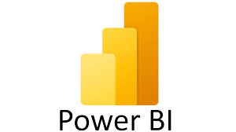
Report on Sales Performance (2022)

Slide 2
CURRENCY
After careful EDA, I could see that there is no much difference in the Average Selling Value(Currency) across all the Countries.
Hence, I came to a conclusion that the Given Value(Currency) is already given in a common currency. I have assumed the common currency to be AED.
So, I have done all the Visualization based on the Given Value as AED.

Slide 3
Data Preprocessing
Initially, Preprocessing step like checking for null values is implemented in the dataset.
After checking for null values under each column, I have found that under the Value column there were nearly 10% of the rows had null value present in the dataset.
Before uploading the dataset into Microsoft Power BI, the null value rows are removed.
The main reason for deleting the null values from the dataset is to get an accurate overall value. The null values can give an inaccurate overall value and affect the visualization.

Slide 4
Power BI Visualization(Images)

Slide 5
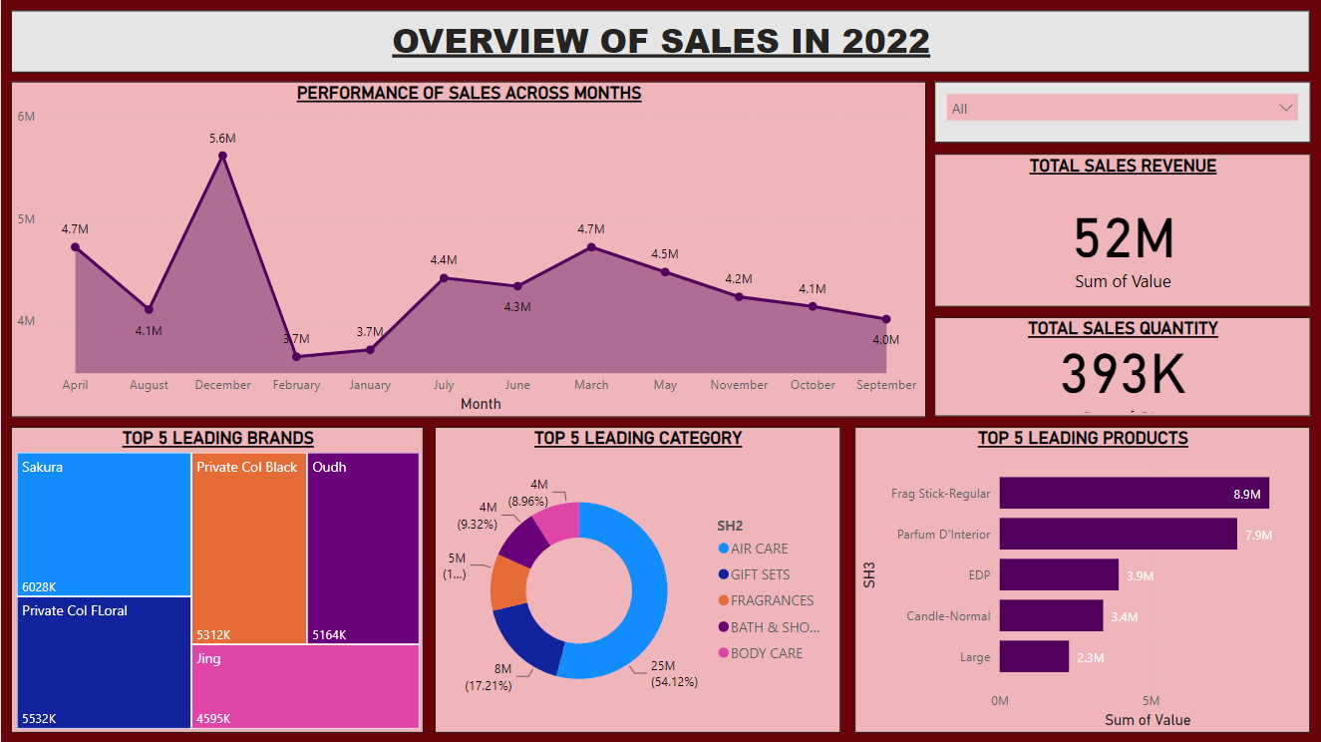

Slide 6
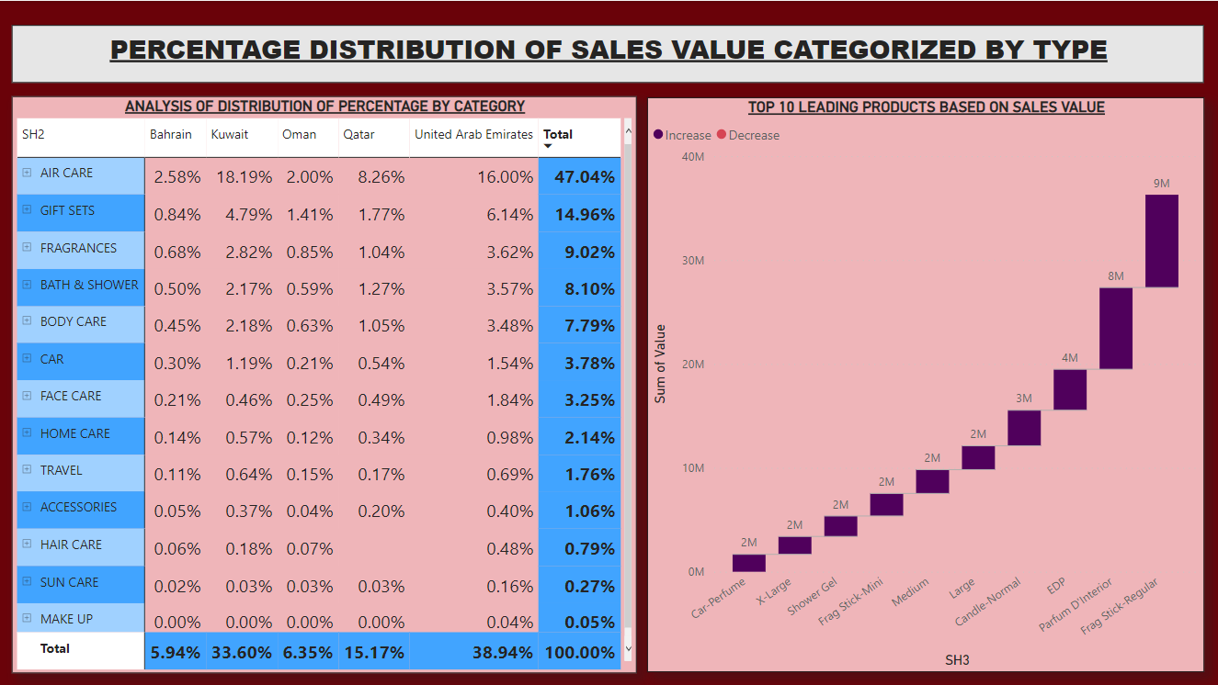

Slide 7
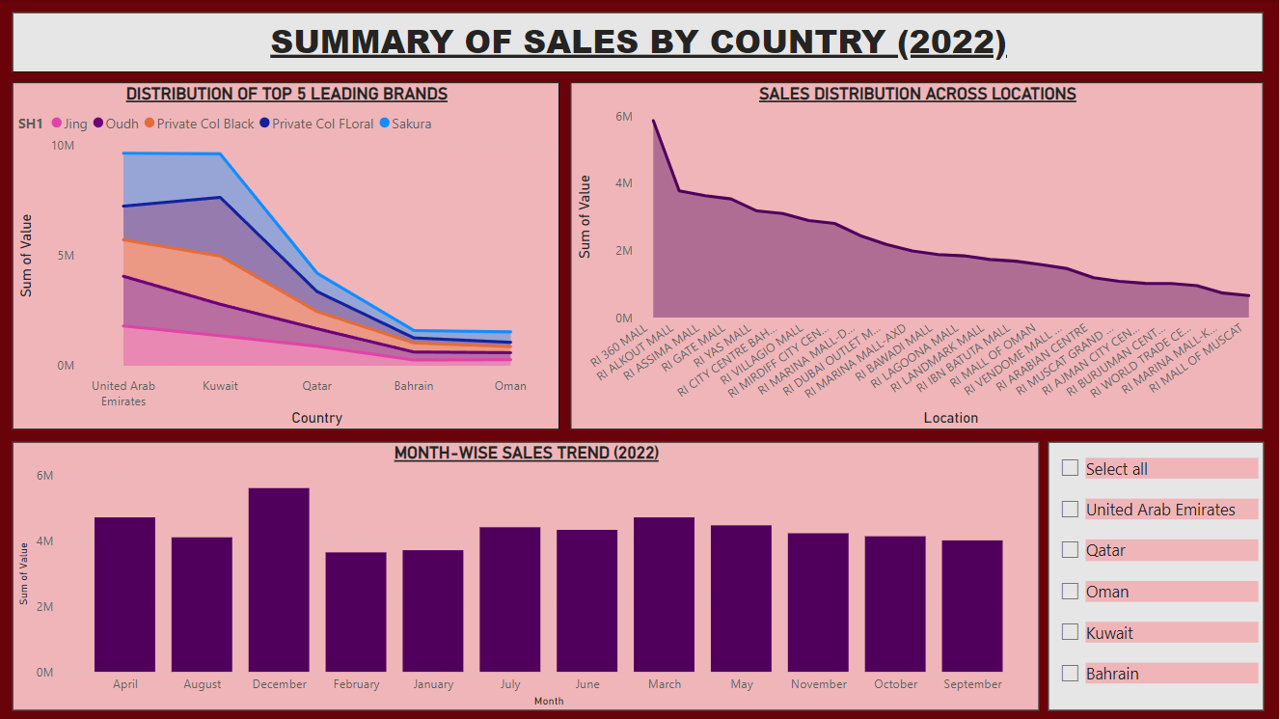

Slide 8
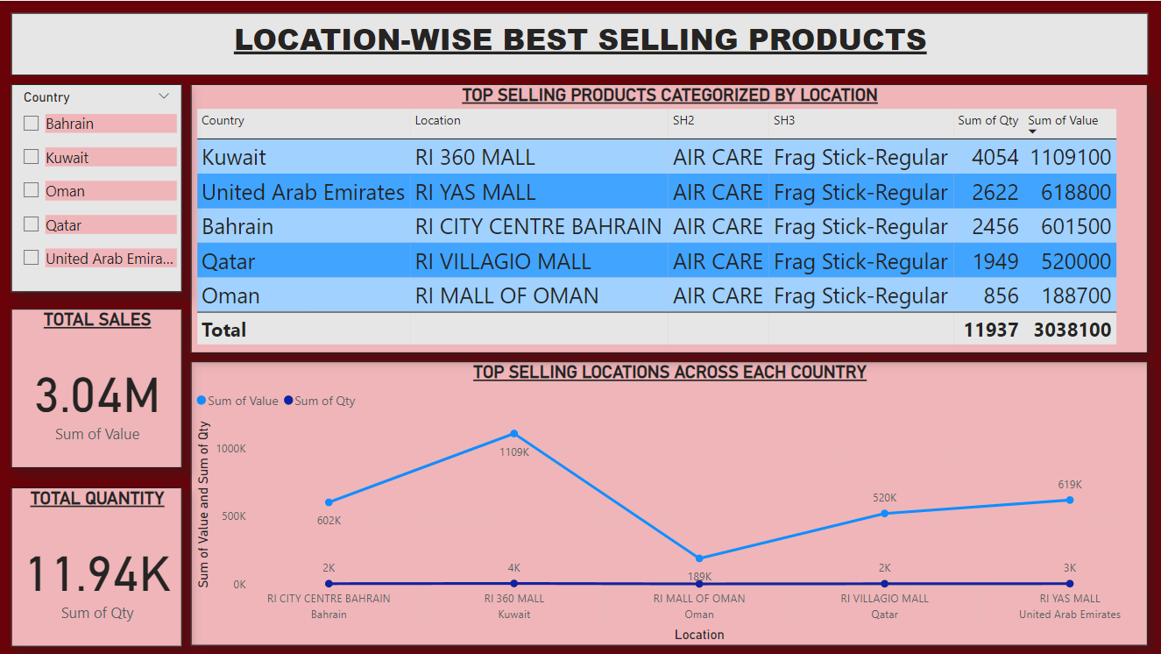

Slide 9
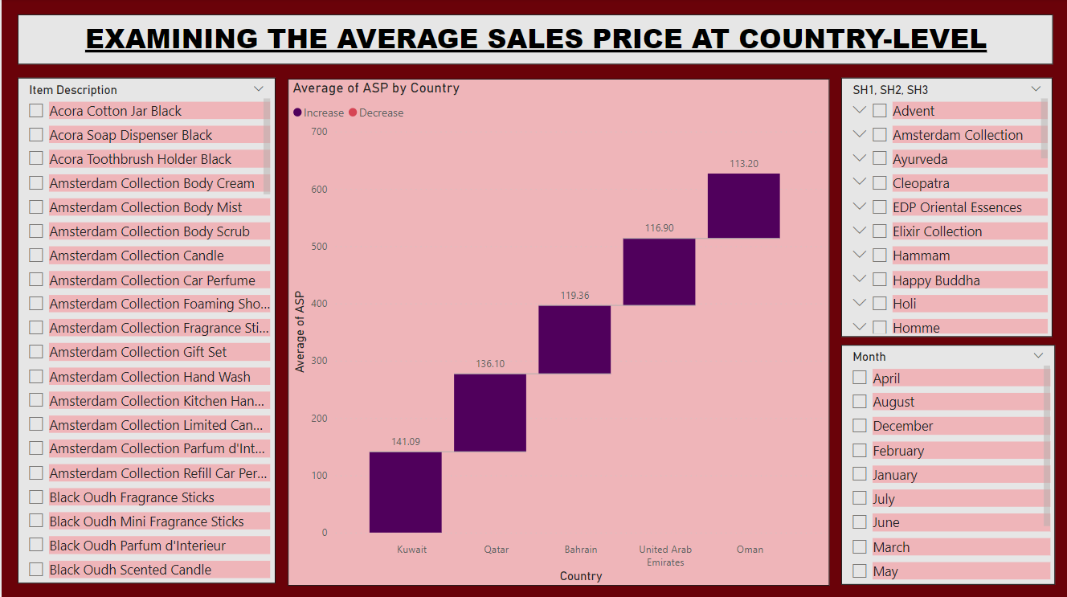

Slide 10
Key Insights
Approximately 40% of the total sales value across all countries in the Middle East region is primarily attributed to the United Arab Emirates, as it significantly drives the sales value.
The countries of Qatar, United Arab Emirates, and Bahrain have recorded the highest combined sales value in the month of December 2022.
Among all SH2 and products falling under the SH3, "Air Care" has registered the highest sales value across all countries. The product Frag Stick Regular has attained the highest sales value compared to other products in the SH3 across all countries.
The data on sales indicates the most successful areas in terms of overall sales value, such as RI City Centre located in Bahrain, RI 360 Mall situated in Kuwait, RI Mall of Oman found in Oman, RI Villagio Mall located in Qatar, and RI Yas Mall situated in UAE. These areas have demonstrated exceptional sales performance and have played a crucial role in generating the overall sales revenue in their respective countries.

Slide 11
Key Suggestions
Special focus should be given to the high-performing locations such as RI City Centre in Bahrain, RI 360 Mall in Kuwait, RI Mall of Oman in Oman, RI Villagio Mall in Qatar, and RI Yas Mall in UAE due to their outstanding sales performance. These locations have played a significant role in boosting the overall sales revenue in their respective countries.
Due to the fact that the United Arab Emirates constitutes approximately 40% of the overall sales value across all countries in the Middle East region, it is imperative to maintain emphasis on sales and marketing efforts in the UAE.
Expanding their product offerings in the "Air Care" category is recommended for Business Units, as this category has generated the highest sales value among all countries.
To increase sales, businesses may want to offer promotions and marketing campaigns in December, as it has been observed to have the highest total sales value in Qatar, United Arab Emirates, and Bahrain.
The product Frag Stick Regular deserves extra focus since it has recorded the highest sales value among all the other products belonging to the SH3 category across all countries.

